Slide 1


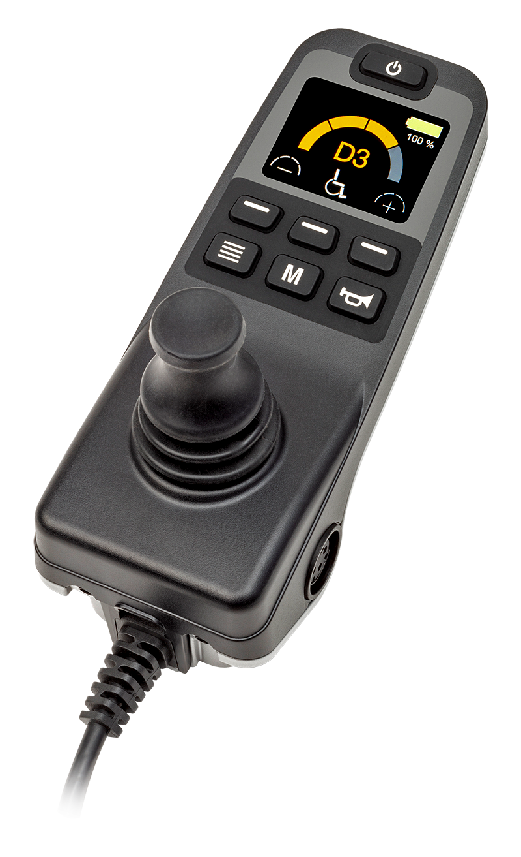
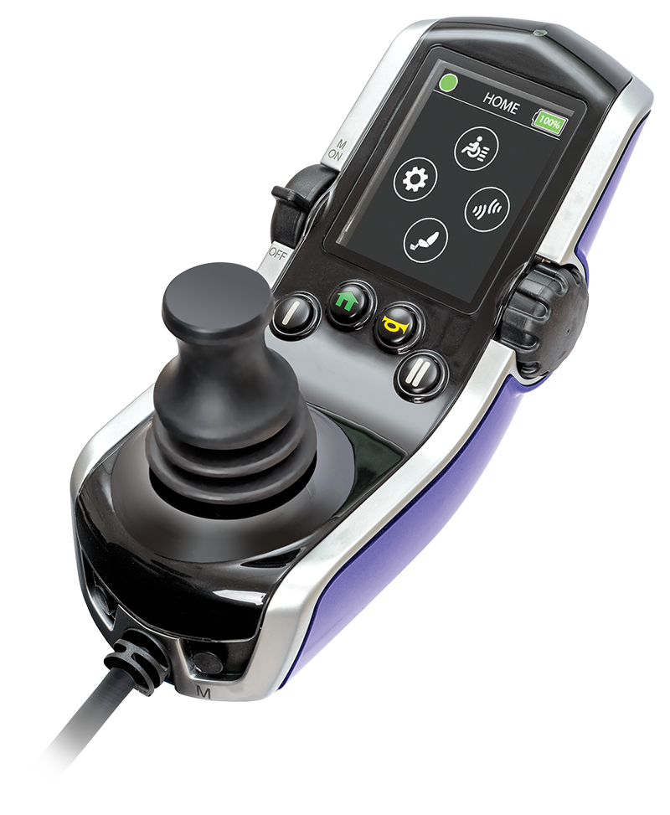


Slide 2
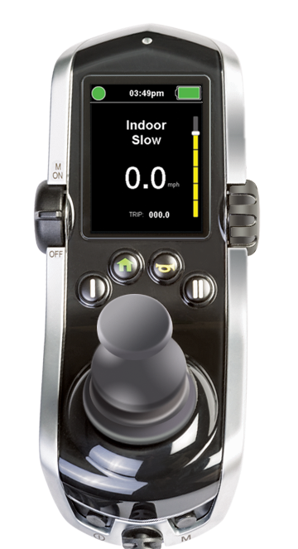
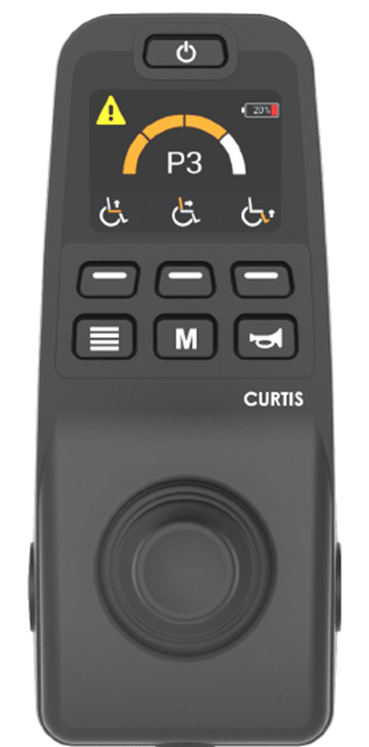
Joystick Clinical Comparison
Q-Logic 3e
Q-Logic 3 EX
DISPLAY
Button based, no dials or toggles
Screen is icon based (no words)
Color LCD screen
FUNCTION
Programmable soft keys
  iAccess type functionality where multiple pages can be programmed
Bluetooth® for programming only
  If client needs to control Bluetooth items through joystick then go to the Q-Logic 3 EX
Operates up to 5 actuator functions
Supports Interactive Assist
Still allows programming as proportional or switch operation through joystick
Recommended for joystick users overwhelmed by the EX controller/operation
DISPLAY
Can customize text or icon-based profile labels
Speed dial and on/off toggle
FUNCTION
Speed dial vs. button speed adjust
Toggle on/off button
Programmable I/II buttons or option for additional iAccess add on
Operates up to 5 actuator functions
Bluetooth® capability to pair to client’s phone or computer
Infrared (IR) capabilities
Supports Interactive Assist
Programming for alternative drive control needs
Q-Logic 3 EX joystick can be replaced in the field with
proper hardware and no additional harness.

Slide 3
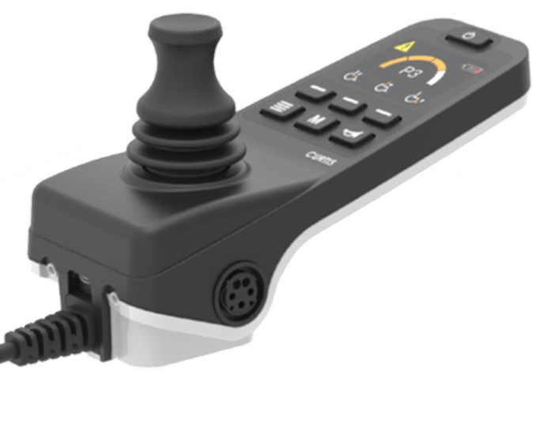
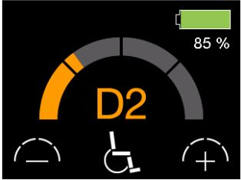
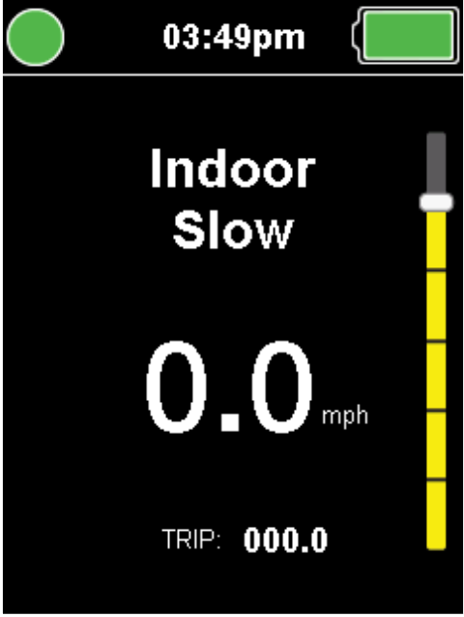
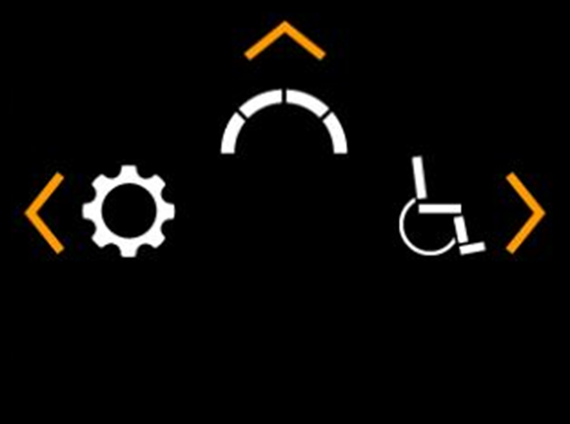
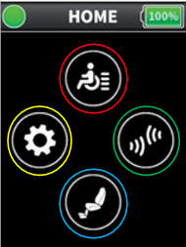
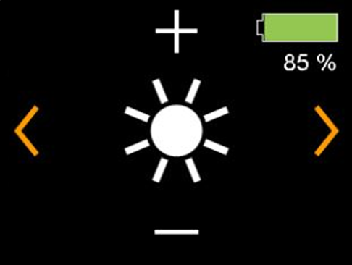
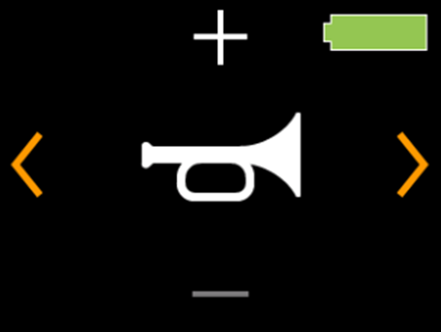
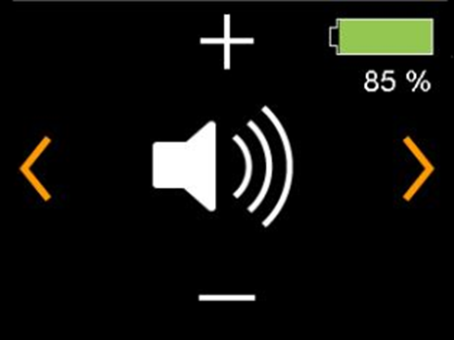

Q-Logic 3e Hardware:
XLR charger port
USB-C charger port
On/off port
Mode port
Q-Logic 3e
Q-Logic 3 EX
Forward Command to
go to Drive Profiles
Q-Logic 3 EX
Home Menu
Left Drive Command for Settings
Right Drive Command for Seat
Brightness
Has Bluetooth® for user connectivity
Horn Volume
Beep Volume

Slide 4
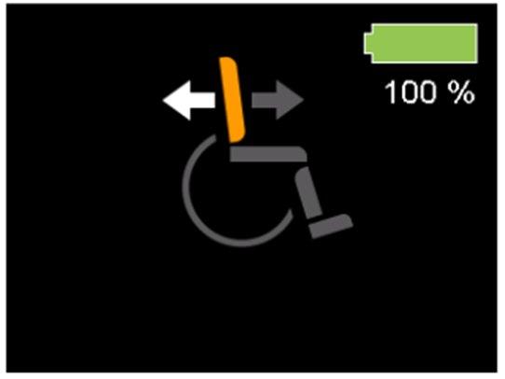
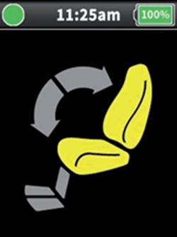
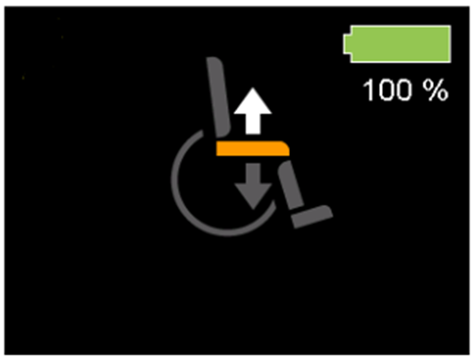
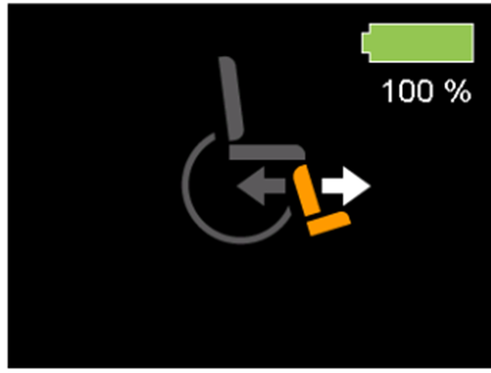
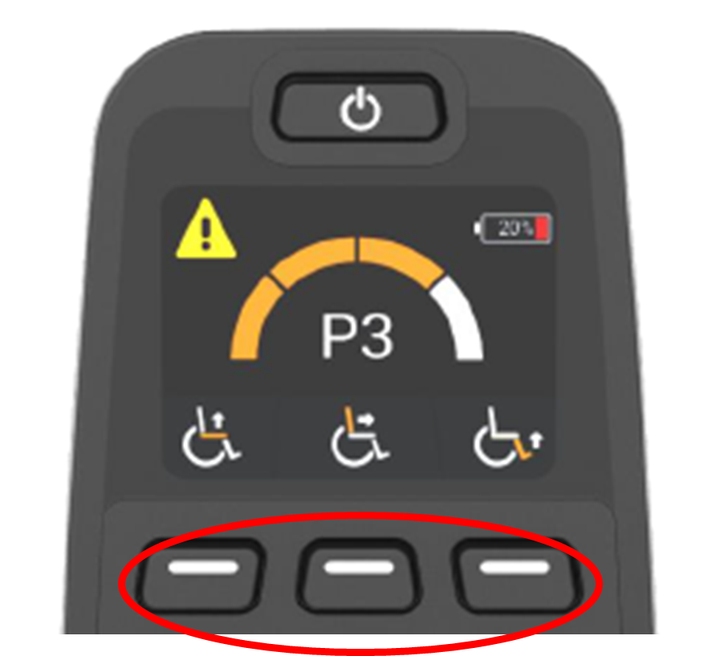
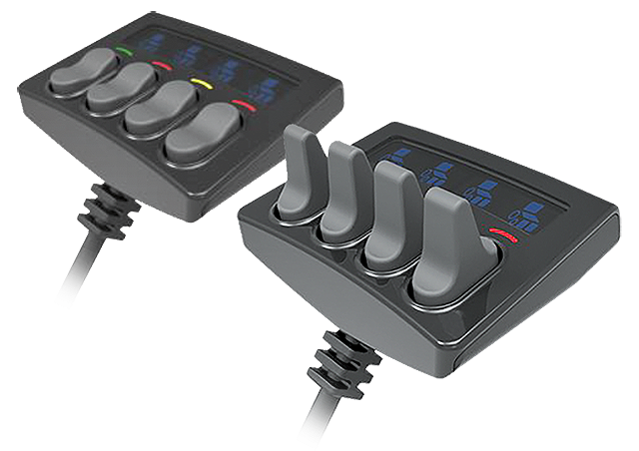
Q-Logic 3e Seating Screen
Q-Logic-3 EX Seating Screen
Soft Key Customization:
Essentially a built-in iAccess that can have multiple pages
Can be programed per profile
  Seat Functions
  Bluetooth® hot key (takes you right to the Bluetooth screen)
  Home screen
  Speed up/speed down (similar to speed pot on EX Joystick)
iAccess Module:
Can have 1-19 different functions
Single or multiple pages
Flat or toggle buttons for:
  Seating
  Lighting (if LED kit)
  Bluetooth® mouse clicks etc.

Slide 5
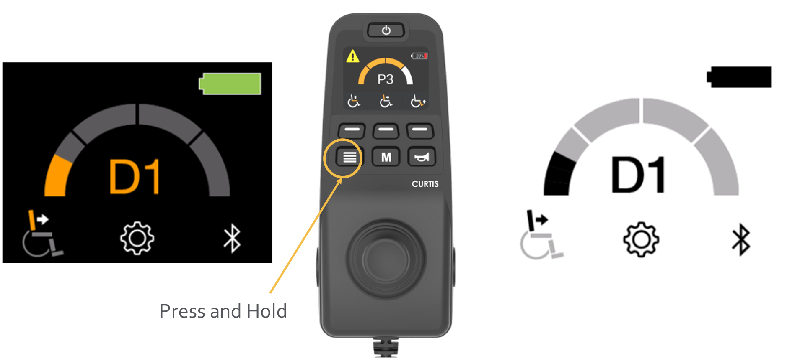
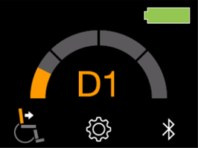
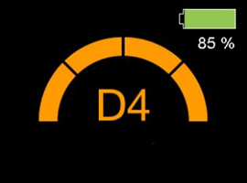
Q-Logic 3e
For those that need potentially all power positioning but an alternative user interface
For those not needing functions for:
  Alternative drive controls
  Environmental controls
Ability to hold the “page” button to swap screen display for improved visual for indoor vs. outdoor lighting
Can do a lot of the same functions as Q-Logic 3 EX such as:
  Device double command for mode changes
  Same jack commands
    Short, double, and long command
  E-stop (for on/off and mode jacks)
  Custom mapped I/O for mode jack only
Speed Dial Types
Profile Speed:
The speed bar represents the total speed of the power chair.
If multiple drive profiles are programmed in, then the speed will only highlight up a certain amount, relative to the max speed of the power chair.
Speed Pot:
The half circle will go up all the way in each drive profile.
Instead of showing the overall speed of the chair, the speed bar represents the speed of the drive profile shown.

